Slide 1

NASI SPONSORZY I PARTNERZY

Slide 2

The Top Customer Problems: How to Avoid Calling Bob
Bob Ward
Principal Architect
Microsoft
bobward@Microsoft.com

Slide 3
And the Winners Are….
My SQL Server is not performing well
I’m having backup/restore issues
My Database is not consistent
My Server is the exception
Does anyone understand these Errors?
I Can’t Start My SQL Server
SQL Server is losing its memory

Slide 4

My SQL Server is not Performing Well
My SQL Server is “Slow”
My queries are timing out
My query is now “slow”
Overall Server
High CPU
I/O bottleneck
Blocking
Latch Waits
Other Waits
Specific Query
Running
Waiting
RUNNING
Live
Port-Mortem
Perf Dashboard Reports
DMVs
PSSDiag
SQLNexus
WAITING
Notes:
The reason for post-mortem we use PSSDiag is to do an uber-collection so we don’t have to collect data for yet another instance of the problem to occur. But if you catch it live the 2nd time you may be able to use Perf Dashboard reports and DMVs to solve it.

Slide 5
I’m Running
Not SQL Server
Another Process
High Kernel Time from Drivers like Anti-Virus
SQL Server
Background Task?
High Compiles or Recompiles
It’s a Query(ies)
Query Execution
Cardinality Estimation
Poor index design – Check missing index DMVs
Poor Query Design – “I forgot a WHERE clause”
Parallelism – What MAXDOP to use? See here
Example: Resource Monitor spin
Look for scans
DOP can be
opportunity for tuning

Slide 6
Cardinality Estimation Problem Scenarios
Issue | Behavior | Solution
Stats missing/stale | “Guessed” or based on current stats | Create index/stats or update stats. Read here
Parameter Sniffing | Based on value when cached | OPTION hints or local variables. More info here
Table Variable | Estimate = 1 row | Use temp tables or hints
TVF | Estimate = 1 row for multi-statement | Put into temp table. Read here
Local Variable | Density of comparing column | OPTION (RECOMPILE)
Data Type Mismatch | Can’t use index or stats (“Guessed”) when upgrading column | Change column types
Row Goals | Estimates scaled back | Query Hints. Read here
Data Correlation | Estimates assume no correlation between columns | Query Hints. Read here
UDF | Can’t use index or stats (“Guessed”) | Use computed columns. Read here
Arithmetic in expression | Can’t use index or stats (“Guessed”) | Use computed columns. Read here
Optimizer Bugs | They are just “wrong” | Consider fixes with trace flag 4199. Read here
SQL2014 New CE

Slide 7
I’m Waiting
Blocking
I/O bottleneck (PAGEIOLATCH, WRITELOG)
Latch Waits (PAGELATCH, LATCH_XX)
RESOURCE_SEMAPHORE* waits
Other Waits
Query Execution Problems could cause these
Your app
Your I/O path
Could be hot page or “something else”
Sort/Hash or compile memory
Check DMVs
Poor query plan can result in waits
Maybe you don’t have
enough cache or RG I/O cap

Slide 8

Demo
It’s just slow with
High CPU
Notes:
Go through README.TXT file for demo1_performance

Slide 9
I just want to create a backup
OS Error 64
Network issue
Could be TCP offloading
OS Error 1450
OS Memory problems
Transaction log grow
Full recovery requires a log backup to truncate
VDI backup failure
Almost always the VDI application
Remote uses
File system cache
System Center Advisor
alert
Ex. RedGate
SQL Backup

Slide 10
The Restore Story
Support advice
Runs Slow
Corrupt db or media
Restoring over existing db
Disk Bottleneck
Use BACKUP with CHECKSUM
Regularly use VERIFYONLY
WITH CONTINUE_AFTER_ERROR an option
If the restore is bad, you can’t get back original
Options may be limited to get back up and running
Rebuild log can lead to inconsistency
Recovery takes long
VLF fragmentation
Verifies db checksum and
writes media checksum
We see this alot

Slide 11
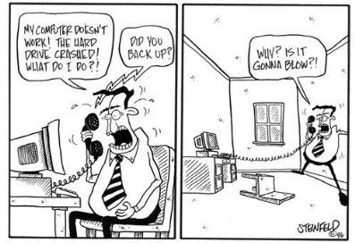
Demo
Can I get around a
corrupt backup?
Notes:
Run steps in readme.txt file in demo2_backup_restore

Slide 12
My Database is not Consistent
Symptoms
Msg 824 error
DBCC CHECKDB errors
What do we do?
Restore
Help you extract data
Repair
Assertions, AV, hangs
Suspect DB or Deferred transactions
Paul Randal blog posts
great resource
We don’t have
“magic” repair tools

Slide 13
How checksum works
After read retry
Failed 4 times
Acquire Latch
Msg 824
Assume PAGE_VERIFY= CHECKSUM
Page 100
m_tornbits=0
m_flagbits=0
berrcode=-4
Checkpoint or LazyWrite
BUF Page 100
123456789
Abcdefghijklm
Page 100
m_tornbits= -461750136
m_flagbits=0x0200
Re-calc m_tornbits = -461750138
123456789
Abcdefghijklm
Page 100
m_tornbits= -461750136
m_flagbits=0x0200
Get Page 100 from disk
123456789
Mavsrule.mdf
Abcdefghijklz

Slide 14
How can this happen?
SQLIOSIM
Constant page
sniffing
Replay the tlog
I/O Path
Memory corruption
Bugs

Slide 15

Demo
Recovering from lost
Data quickly
Notes:
Follow instructions in readme.txt in demo3_database_consistency

Slide 16
My SQL Server is the Exception
2013-10-27 15:32:31.23 spid51 Using 'dbghelp.dll' version '4.0.5'
2013-10-27 15:32:31.24 spid51 ***Stack Dump being sent to C:\Program Files\Microsoft SQL Server\MSSQL11.MSSQLSERVER\MSSQL\LOG\SQLDump0023.txt
2013-10-27 15:32:31.24 spid51 SqlDumpExceptionHandler: Process 51 generated fatal exception c0000005 EXCEPTION_ACCESS_VIOLATION. SQL Server is terminating this process.
2013-10-27 15:32:31.24 spid51 * *******************************************************************************
2013-10-27 15:32:31.24 spid51 *
2013-10-27 15:32:31.24 spid51 * BEGIN STACK DUMP:
2013-10-27 15:32:31.24 spid51 * 10/27/13 15:32:31 spid 51
2013-10-27 15:32:31.24 spid51 *
2013-10-27 15:32:31.24 spid51 *
2013-10-27 15:32:31.24 spid51 * Exception Address = 000007FA24D9FE2E Module(sqldk+000000000000FE2E)
2013-10-27 15:32:31.24 spid51 * Exception Code = c0000005 EXCEPTION_ACCESS_VIOLATION
2013-10-27 15:32:31.24 spid51 * Access Violation occurred reading address 0000000300000020
2013-10-27 15:32:31.24 spid51 * Input Buffer 116 bytes -
2013-10-27 15:32:31.24 spid51 * select * from vw_mscentralserverconfigs(nolock)

Slide 17
Does anyone understand these errors?
Deadlocks – Msg 1204
System Health Session records these by default
Almost always application design
I/O delay warning – Msg 833
Almost always an I/O path problem
Assertions – Msg 3624, 17065, 17066, 17067, 17047, 17075
Rarely seen; A “poor man’s” error.
Be sure not a “victim”, otherwise probably a bug
Non-yielding Scheduler – Msg 17883
One thread not properly yielding to others
If not a “victim”, probably a bug
Deadlock Scheduler – Msg 17884, 17888
Latch timeout – Msg 844, 845, 846, 847
Now NEW work can get done but everyone yielding
Most often a long blocking chain
Avg disk sec/transfer may not always show the problem
BUF – could be I/O
Non-BUF – could be autogrow
15 sec I/O delay
SQL Server has encountered <n> occurrence(s) of
I/O requests taking longer than 15 seconds
stack
dump
5 minute wait
error_reported XEvent
Notes:
If you have no idea what query caused an error or want to trigger a dump, use the error_reported Xevent.

Slide 18
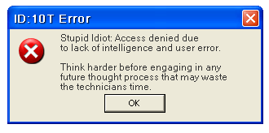
Demo
“I love errors” – Bob Ward
Notes:
Go through readme.txt in demo4_errors_and_exceptions. Probably only have time to go through errorlog.assert_and_av.txt

Slide 19
I can’t start my SQL Server
Permission problems
Registry, folders, ERRORLOG file, system dbs
We’ve seen this a lot after a hard restart
Configuration
Parameters wrong
‘max server memory’ to low
Lock pages –T834 requires contiguous memory
Damaged Files
System Databases
Corrupt installed executables
Backup tail of log of MODEL
If you do this and restart, boom!
2012 has editor
Keep file copies
Keep these in-reach
Older version maint plans
allowed this
Notes:
Model issue documented in http://support.microsoft.com/kb/822852 but engine still allows this.

Slide 20
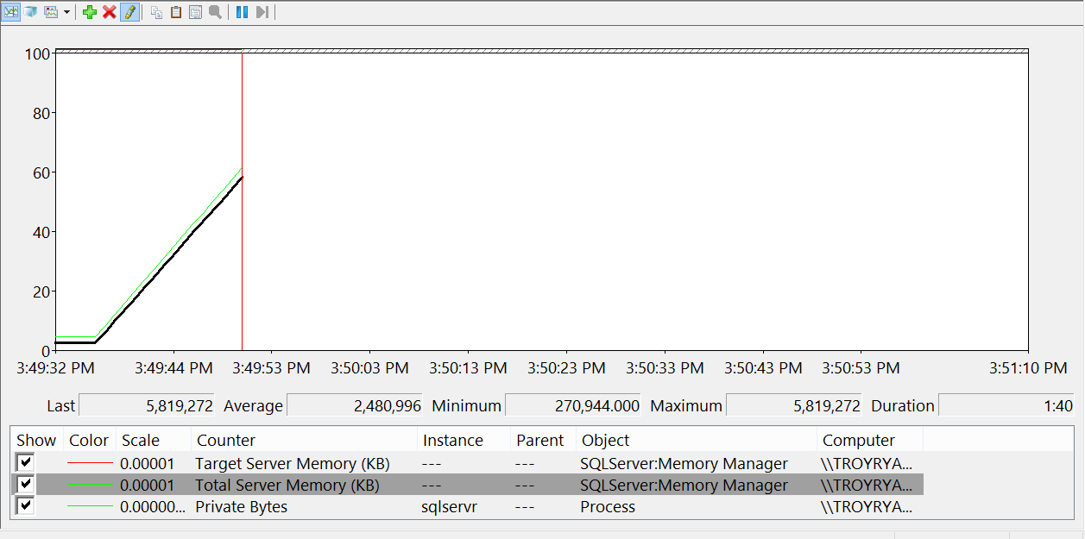
This is not a memory leak

Slide 21
My SQL Server is losing its memory
Memory Usage Doesn’t Look Right
My memory is growing
My memory is leaking
Memory doesn’t look right in Task Manager
A cache keeps growing out of control
My plan cache keeps dropping
Out of Memory Errors
“max” is not “max” enough
Someone is stealing my memory
I really am leaking memory
Memory is causing to block
RESOURCE_SEMAPHORE
RESOURCE_SEMAPHORE_QUERY_COMPILE
CMEMTHREAD
We grow until target
Locked pages
Use –f to get out of jail
Look at the clerks and objects
Sorts and hashes
Query compilation
scalability

Slide 22

Demo (if time)
I must be losing my memory
Notes:
Follow the instructions in readme.txt in demo5_memory

Slide 23
Let’s Review
Performance is all about Running vs Waiting
Check out Performance Dashboard Reports and SQLNexus
OS Errors during BACKUP are usually not SQL Server
Use BACKUP with CHECKSUM
Recovering from corruption is restore or repair
Deadlocks are captured by default in system_health session
Keep backups of system db and media files handy
SQL Server memory growing is not the sign of a leak

Slide 24
References
CSS Escalation Engineer Blog
Paul Randal’s Blog
SQL Server 2012 Performance Dashboard Reports
PSSDiag on CodePlex
SQLNexus on CodePlex
Troubleshooting Query Performance: Cardinality Estimation

Slide 25

NASI SPONSORZY I PARTNERZY
Organizacja: Polskie Stowarzyszenie Użytkowników SQL Server - PLSSUG

